Slide 1
LVDT (Linear Variable Differential Transformer)

Slide 2
LVDT is an acronym for Linear Variable Differential Transformer.
It is a common type of electromechanical transducer that can convert the rectilinear motion of an object to which it is coupled mechanically into a corresponding electrical signal.
Based on faradays law of Induction in a coil
The law specifies that the induced voltage is equal to the rate at which the magnetic flux changes through the circuit.
LVDT linear position sensors are readily available that can measure movements as small as a few millionths of an inch up to several inches.
The transformer's internal structure consists of a primary winding centered between a pair of identically wound secondary windings
LVDT - Linear Variable Differential Transformer or Transducer Working - YouTube

Slide 3
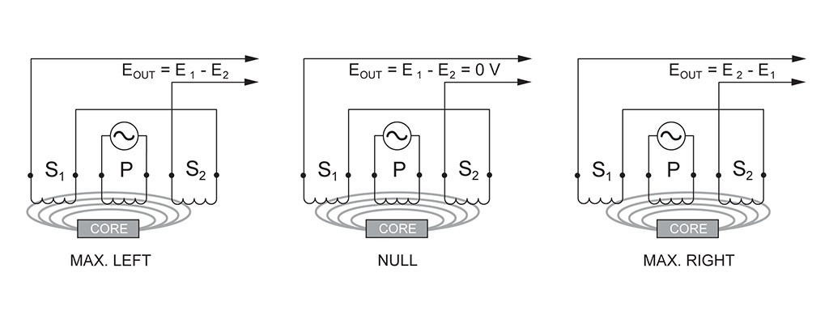
Basic Circuit

Slide 4
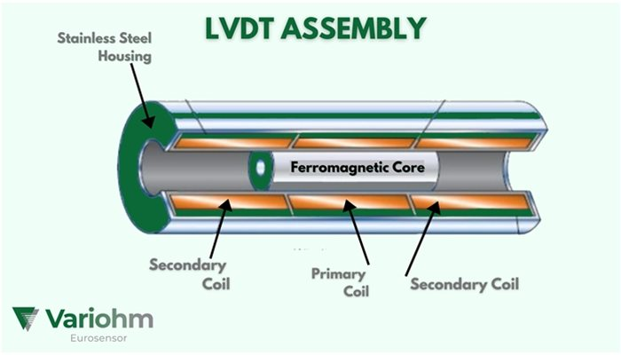

Slide 5
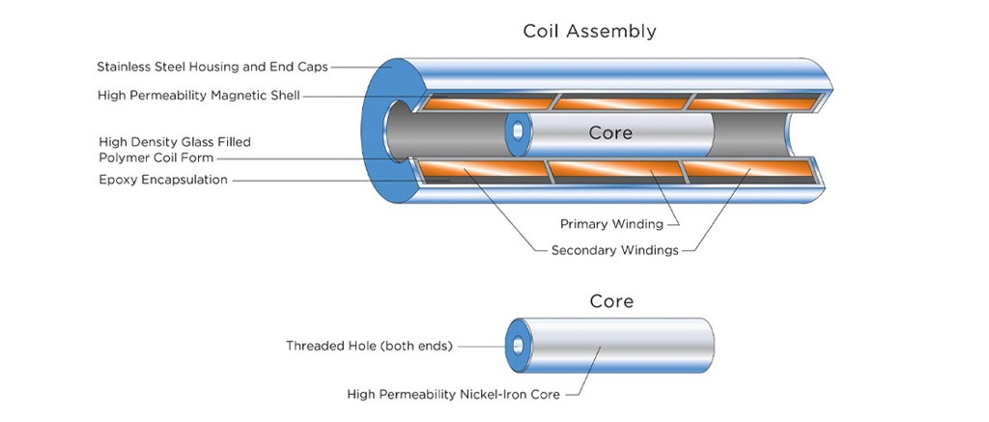

Slide 6
Advantages of LVDT
Friction-Free Operation
Infinite Resolution
Unlimited Mechanical Life
Overtravel Damage Resistant
Single Axis Sensitivity
Separable Coil And Core
Environmentally Robust
Null Point Repeatibility
Fast Dynamic Response
Absolute Output

Slide 7
Disadvantages of LVDT
Relatively large displacement are difficult to measure
Sensitive to stray magnetic and electric fields
Dynamic response is slow
Applications of LVDT
Primary transducers
Secondary transducers

Slide 8
RVDT (Rotary Variable Differential Transformer)

Slide 9
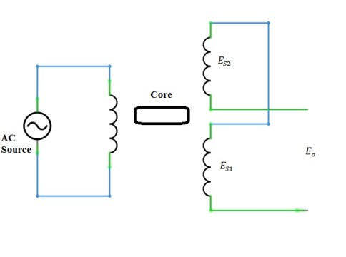
Basic Circuit

Slide 10
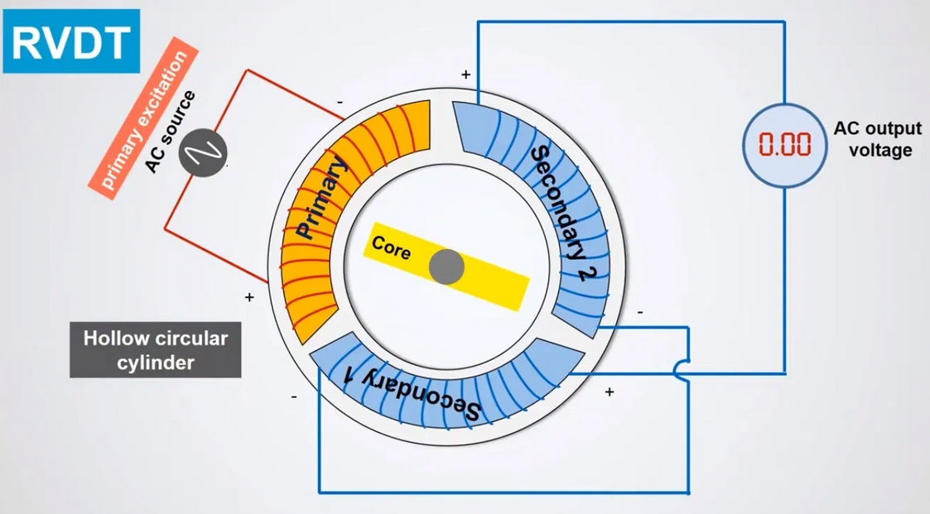
Basic Circuit

Slide 11
Working
Can convert the rotary motion of an object around an axis into a corresponding electrical signal.
RVDT is passive transducer because it require external power source for their operation.
In the RVDT circuit AC excitation is connected with the primary winding.
Rotary ferromagnetic core is between the winding E_{S1} and E_{S2} are the induced emf of the winding.
E_{o}=E_{S1}–E_{S2}
When the shaft of the RVDT will rotate the mutual inductance of the winding will change linearly due to angular displacement

Slide 12
Advantages of RVDT
Durability
Low cost
Easy to manage
Repeatable performance
Resolution is infinite
Linearity is excellent
Long life span
Consistency is high
High exactness
Construction is compact and strong

Slide 13
Disadvantages of RVDT
It restricts the usability the output of the RVDT is linear about 40° and -40° due to which its usability is limited
Stray Electromagnetic field can effect the operation and influence the output.
More bulky, as compared to Resistive type potentiometers for angular measurements.

Slide 14
Applications of RVDT
Hydraulic pumps
Valve positioning
Rotary actuators
Modern machine tools
Control cockpit
Robotics
Process control industry
Aircraft
Ecological control system
Engine fuel control

Slide 15
OPTICAL ENCODERS

Slide 16
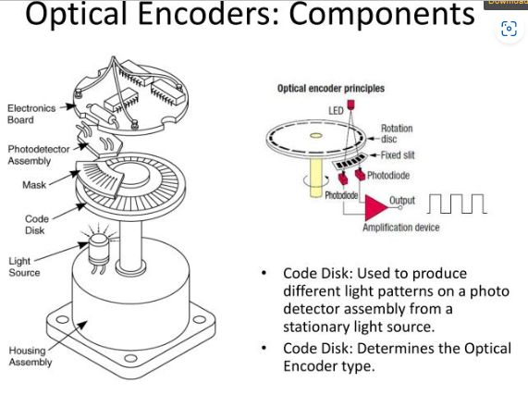

Slide 17
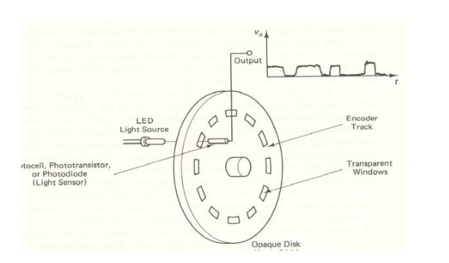

Slide 18
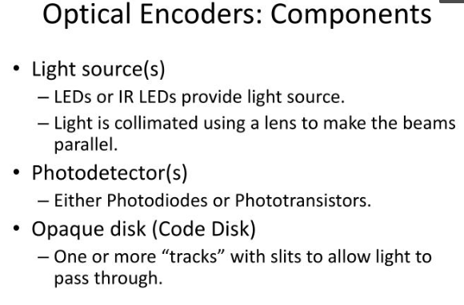

Slide 19
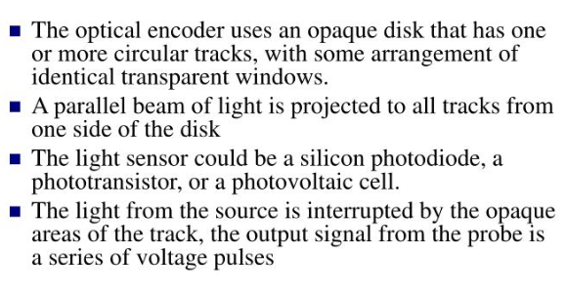

Slide 20
https://youtu.be/k2GQVJ4z0kM

